Slide 1
Developing a novel Clinical User Interface for NLP

Slide 2
Disclaimer
The opinions of the presenters are their own and do not represent the official opinion of the Department of the Army, Department of the Air Force, the Military Healthcare System, the Department of Veterans Affairs or the Department of Defense. All patient data is fictious.

Slide 3
Introduction
Presenters
Selected design articles
Discussion of 2014 article focusing on UX and NLP
Presentation of our NLP engine (LExC)
Conclusion/questions

Slide 4
Presenters
David Alt, MD, FAAP
Justin Stewart, DO, MBA, MHA
Notes:
Dr. Alt is a Board-Certified Pediatrician currently in the Clinical Informatics Fellowship here at Madigan Army Medical Center (we will refer to it as MAMC from now on). He has been in for 10 years, completed degree at Uniformed Services University, residency at Naval Medical Center Portsmouth, and stationed at Laughlin AFB prior to coming here to MAMC. Dr. Stewart is a Board-Certified Internal Medicine Physician who received his DO from the University of North Texas Health Science Center—Texas College of Osteopathic Medicine (TCOM for short). He has been in the Army for 16 years and has deployed to Iraq in support of Operation Iraqi Freedom and Afghanistan in support of Operation Enduring Freedom. He also has a MBA and MHA from Baylor University.

Slide 5
Introduction
“Confusion and clutter are failures of design, not attributes of information.”¹
How often is design taken into consideration when developing the User Interface?
Notes:
As I worked on this presentation, I found a quote which sums up the interaction between user interface and data. This quote is taken from Dr. Tufte. According to his website, “Edward Tufte is a statistician and artist, and Professor Emeritus of Political Science, Statistics, and Computer Science at Yale University. He wrote, designed, and self-published 4 classic books on data visualization. The New York Times described Dr. Tufte as the "Leonardo da Vinci of data," and Bloomberg as the "Galileo of graphics.”” (say quote on slide) Dr. Tufte’s quote in my opinion does an excellent job of highlighting the problems we face in using NLP to “make sense” of free text data. How often do we take into consideration design when developing user interfaces for Health Information Technology?
Tufte, E.R. (1990). Envisioning Information. Connecticut: Graphics Press. (p. 53)

Slide 6
Quotes from Journal Articles
“Our proposal for a graphical summary should encourage doctors and nurses to reshape, perhaps re-invent, the medical record before computer programmers cast institutional convenience into silicon.”²
“Physician preference for adopting a certain reading/retrieval order appeared to be a function of what best fits their workflow while fulfilling the stimulus demands.”³ (BLUF)
AMA sites do have guidelines, but do not seem to incorporate usability in them.⁴
Notes:
Dr. Tufte published an article in Lancet in 1994, ”Graphical summary of patient status.” In that article he demonstrated a way to depict key aspects of the hospitalization both graphically and with text. This quote is taken from the conclusion of that article. Even though it was published in 1994, it is even more applicable today.
An article published by Rizvi and associates looked at note entry and reading styles in two different EHR systems and found that, “…”. This probably comes as no surprise to us at all as physicians prefer the summary first (in the military we call it the Bottom Line Up Front or BLUF) in order to quickly glean the important clinical information as quickly as possible. (A comparative observational study of inpatient clinical note-entry…Int J Med Inform. 2016 June ; 90: 1–11. doi:10.1016/j.ijmedinf.2016.02.011)
Interestingly enough, the American Medical Association has published guidelines that their websites follow in the March 2000 issue of JAMA. Under the first section of the guidelines there is a section called, “Navigation of Content.” There are very specific aspects listed such as, “Graphics files should include a ‘mouse over’ indication of the graphical content.” (Guidelines for AMA websites). However there does not seem to be any model or usability heuristics on which to base these specific aspects.

Slide 7
Quotes from Articles (cont)
Mobile devices lead to increased input time and errors.⁵
Inputting numerical data at the bedside with a mobile device varied considerably between mobile devices depending on the user interface.⁶
Notes:
Another thing to consider is mobile devices and the usability in regards to electronic health records.
1) Drews, Zadra and Gleed found that using mobile devices took more time to input data and had increased error rates compared to desktop devices. (Int J Med Inform. 2018 Mar;111:37-44. doi: 10.1016/j.ijmedinf.2017.12.010. Epub
2017 Dec 15.)
2) Bradley, Kuziemsky and Curzon compared the interfaces of six different mobile devices and found variation in the input error rate (0.7% to 18.5%) and length of data entry time (2.81 sec to 14.68 sec). Both time and error rate was significantly improved with a numeric keyboard interface (mean time of entry 3.08 sec and accuracy of 99.3%) JMIR Hum Factors. 2015 Jul-Dec; 2(2): e15.
These studies articulate the importance of design and interface across all types of platforms.

Slide 8
Overview of article
Ease of Adoption of Clinical Natural Language Processing Software: An Evaluation of Five Systems⁷
Introduction
2014 i2b2 (Informatics for Integrating Biology and the Bedside) Challenge had a track called “Track 3—Software Usability Assessment”
Had four “expert evaluators” with computer science training and 8 “end user evaluators” with backgrounds in medicine, nursing, pharmacy and health informatics
Looked at dimensions of communication effectiveness, effort to install, effort required to use
Total of 11 questions used along with formal software testability tool (TURF) to record interactions and “think aloud” data
Notes:
You may or may not have noticed during your fellowship that the user experience of using Natural Language Processing (NLP) engines and electronic medical records is somewhat lacking. Clinicians such as myself with minimal computer science training have difficulty using these engines without significant technical expertise looking over my shoulder to help. This is not your imagination. User experience is bad. And there is evidence to prove it. In 2014 the Informatics for Integrating Biology and the Bedside Challenge added a track that looked at that specific question. The track was called “Track 3—Software Usability Assessment. There were four “expert evaluators” with computer science training and 8 “end user evaluators” with backgrounds in medicine, nursing, pharmacy and health informatics. The event looked at dimensions of communication effectiveness, effort to install and effort required to use. There were a total of 11 questions used with the software testability tool TURF. TURF stands for Task, User, Representation and Function. It is a software that does multiple things to include keystroke logger, ability to capture screen shots and record verbal comments while using software being tested.

Slide 9
Overview of article (cont)
Results
“Overall, the ease of adoption ratings that the five systems received are unsatisfactory.”
Ease of use and ease of interpreting output average scores were -0.35 and -0.53 respectively
So how do we design better, more clinically appropriate interfaces with NLP software?
Notes:
This one quote from the article does an excellent job of describing the current situation. “Overall, the ease of adoption ratings that the five systems received are unsatisfactory.” Here is the scoring system they used to make that statement. On each of the 11 questions, you were given 2 points for “Effortless or nearly effortless,” 1 point for “Somewhat easy but there are challenges,” no points for “Somewhat difficult,” -1 point for “Extremely difficult, nearly impossible”, and -1 point for "Could not figure it out (operationalized as ‘I was not able to locate it’ or ‘I was not able to get it to work’ depending on the context.” So, how do we design better, more clinically appropriate interfaces with NLP software?

Slide 10
Problem that needs to be solved
The Veterans Health Affairs (VHA) and Military Health System (MHS) have millions of records/clinical notes that are unstructured text
Both health systems are transitioning to the Cerner EHR over the next several years as well as consolidating legacy data from multiple disparate systems into one repository in each health system.
How do we get this data in a clinically usable form to the providers and staff in these systems?
Notes:
The hope of NLP is to be able to mine free-text notes and extract important pieces of information in order to perform an action. Those actions can include making clinical decisions or identifying specific populations of patients that may benefit from additional monitoring. Here at the Military Health System (MHS) we are in the process of transitioning to a new electronic health record (EHR). In addition to the MHS, the Veterans Health Affairs (VHA) is also transitioning to a new EHR. All of the old clinical notes for the most part are unstructured free text. These notes are being transitioned into a large data repository. Also, the new EHR contains many free-text areas where providers put their data. So how do we get this data in a clinically usable form to the providers and staff in these systems, knowing that the user experience is abysmal?

Slide 11
Language Extraction of Clinical Concepts
Interagency contract between both VHA and MHS to purchase NLP with machine learning capability in 2017
Use cases developed in order to create a clinically-friendly user interface
Locate devices that need to be removed as a result of a recall
Locate devices implanted on a certain patient
Search patient records for concepts
View a patient summary supporting primary and specialty care
Notes:
The best way to be able to get the data in a usable form is using a NLP that has the clinician in mind when developing the User Experience. In 2017, the VHA and MHS used an interagency contract to purchase NLP capability as well as develop a more clinically-friendly user experience that was stand-alone and not integrated with the EHR at this time. The name of the UX interface was called Language Extraction of Clinical Concpets (LExC). There were four use cases developed to test this UX interface with the NLP engine. The first use case involved locating devices that need to be removed as a result of a recall. We specifically looked at cardiac pacemakers and defibrillators as the example. For your own learning, I recommend talking to your quality or patient safety personnel to see if there is a standard operating procedure regarding the recall of devices. The second use case involved locating all of the devices that have been implanted on a specific patient. Third, the ability to search patient records for specific concepts such as diagnosis. Finally, being able to view a patient summary supporting primary and specialty care. One of the challenges we face, as I assume we all do, is going through all of the records from all of the providers involved in the care of the patient and trying to determine what has been done in diagnosing or treating the patient. In this presentation, we are going to show mock-ups of the locating of device to be removed as a result of a recall and searching patient records for concepts.

Slide 12
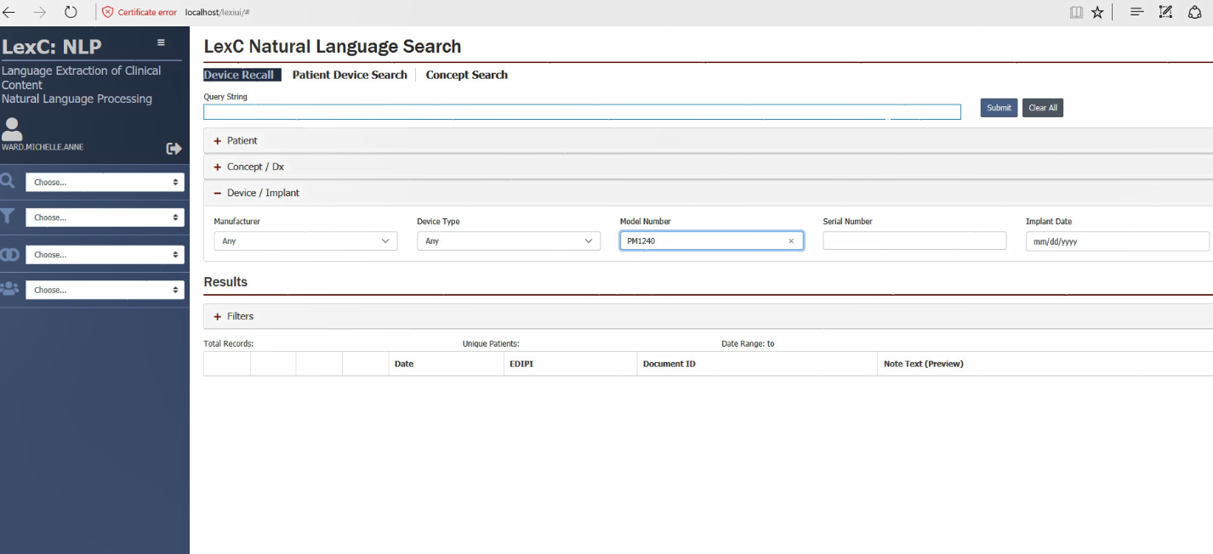
Notes:
The first case we will discuss is the device recall. Allow me to orient you to the slide. You have the ability to expand the areas with a + sign on them. You can search by Patient, Clinical Concept or Device/Implant. Currently we have the Device/Implant area expanded. Let us suppose that a device with the Model Number PM1240 has been recalled and you need to notify the patient. You can enter that number as the search term where the arrow is located.

Slide 13
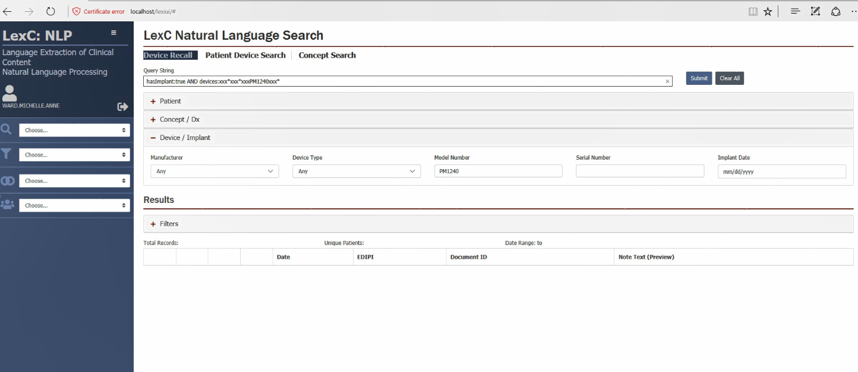
Notes:
One of the interesting features with this application is that it you see the query string that is developed after you type in the search term. One way to think of it is when you search PubMed and use “Advanced Features,” you can see what your search query looks like to Pubmed. This is important as you can save your search queries as part of the API and send them to others for their use. So after you input the search criteria, you see your query string that is circled with the red circle.

Slide 14
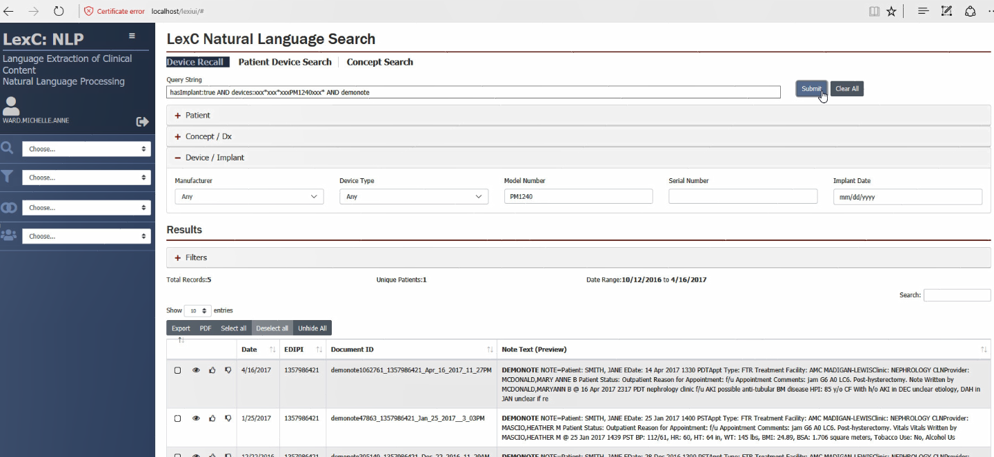
Notes:
After you click on submit, you can see the results of your search criteria on the lower portion of the screen. Please note that these are fake patient notes and there is no PHI or PII contained on these slides. Another interesting feature of the search results is the ability of the system to learn your preferences and improve the search results you receive. The up or down thumb allows you to give input to the system so that it learns how to develop query results for the user. So under the Note Text (preview) section it gives you the first four to five lines of data from the note. You can quickly look to see if the note type is what you are looking for. You can also click on the note to get the full note.

Slide 15
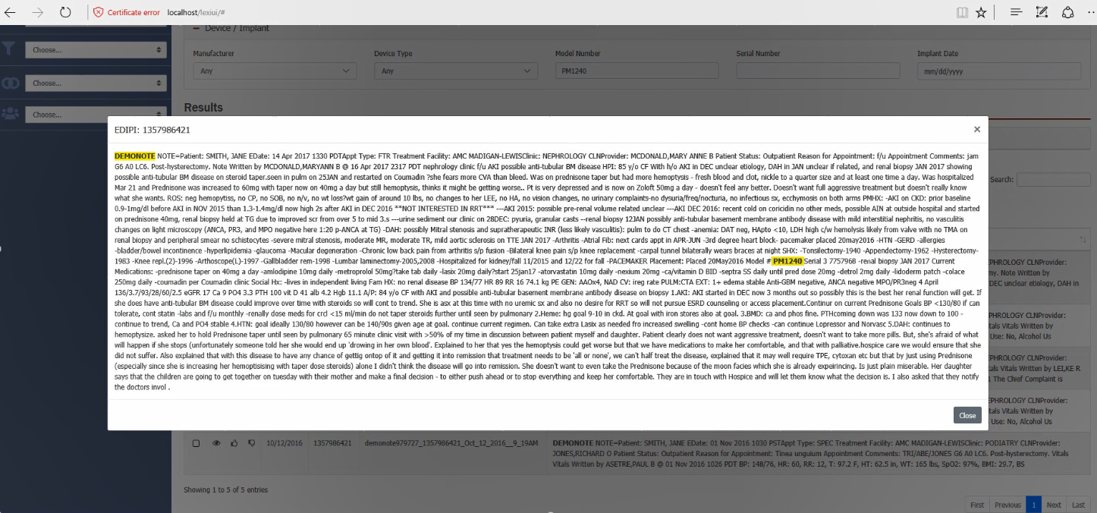
Notes:
This screenshot is what occurs when you click on the note. You are able to view the entire note and the search terms are highlighted. You can download the search results into excel so you can contact the patients that need to be notified of their device being recalled.

Slide 16
Notes:
The next use case for the LExC is to search patient records for clinical concepts. The provider will type in the search term in the box that is highlighted orange.

Slide 17
Diabetes
Notes:
In this slide we typed in the term diabetes to simulate looking for all of the instances where the patient had diabetes as part of the text.

Slide 18
Diabetes
Diabetes
Diabetes
Notes:
As you can see, the interface requires additional search criteria in order for the query to be completed. The additional areas that are needed for the query have the box outlined in red. Also, you can see the query string box being filled as the provider completes the box. This allows the query to be captured for future use and allows back-end evaluation of the queries in the entire system.

Slide 19
Diabetes
Diabetes
Diabetes
Notes:
We added the name “John Little” in the ”Name” box. As you can see, the query requires DOB as well, which is outlined in red. The date of birth is entered here.

